Slide 1
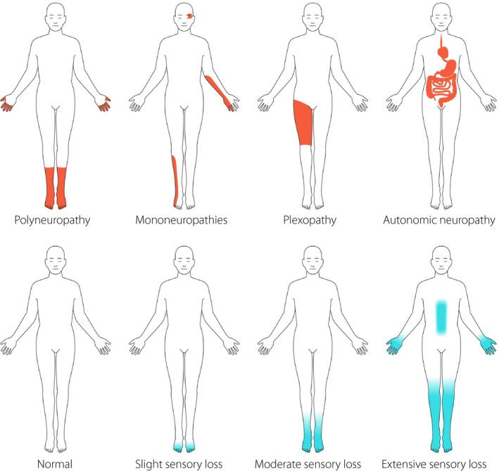
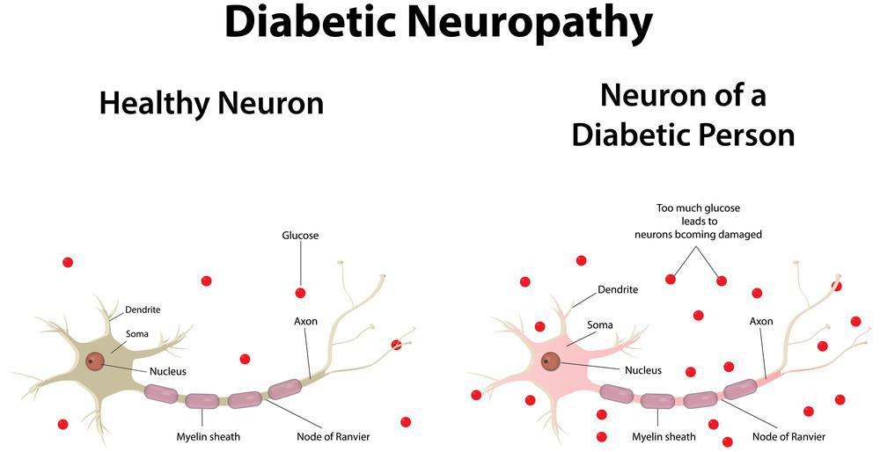
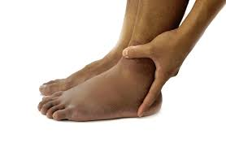
Diabetic Neuropathy
Student’s Name
Instructor’s Name
Course Name
Background Information
Neurological Changes
Diabetic neuropathy is a serious complication of diabetes causing damage to the nervous system. Diabetic neuropathy occurs due to high blood sugar levels which damages nerves throughout the body (Kobayashi & Zochodne, 2018). While it can affects any nerve in the body, diabetic neuropathy often injures those found in the legs and feet.
Nerves are crucial to human body function. They control automatic body functions such as breathing and enable us to send messages about how we feel and move.
Diabetic neuropathy is a common neurological disorder affecting many people in the world. The National Institute of Diabetes and Digestive and Kidney Diseases reports that up to half of people with diabetes are affected by neuropathy.
High blood sugar injures or damages nerves therefore affecting their ability to perform their functions such as transmitting signals. Uncontrolled high blood sugar weakens capillary walls that are responsible for supplying nerve cells with nutrients and oxygen. This can lead to damage of nerve cells which causes pain and can lead to adverse health events.
Physiological changes
Diabetic neuropathy occurs due to the damage of nerve cells by high blood sugar levels. Nerve damage affects the arms, hands, feet and legs. Various physiological changes occur due to diabetic neuropathy including gustatory sweating, heart rate abnormalities, distal anhidrosis, postural hypotension, bladder and colonic atony, impotency, disturbances of respiratory control and diabetic diarrhea.
Symptoms
Treatment
There are four type of diabetic neuropathy including autonomic, peripheral neuropathy, proximal neuropathy and mononeuropathy. The symptoms therefore depend on the type of neuropathy and area affected (Agathos et al., 2018). The common symptoms include:
Pain, numbness and tingling sensation in the hands of feet.
Bloating
Burning sensation at the toes especially at night
Constipation or diarrhea
Muscle weakness
Bladder problems
Erectile dysfunction
Increased heart rate
Nausea
Sensitivity to touch
Vaginal dryness
Vision trouble
There is no cure for diabetic neuropathy, there are however, are pharmacologic and non pharmacologic interventions that can help manage complication, relieve pain and slow the disease’s progression. Keeping blood levels within healthy range is critical to preventing the development of diabetic neuropathy and slowing its progression (Richner et al., 2019). It also relieves some of the disease’s symptoms and reduces complications.
Medication use.
Anticonvulsant drugs, tricyclic antidepressants and opioid medication are prescribed to patients. These medications help with pain management.
Physical therapy
A combination of therapy with medications help to relieve pain and minimize dependence and addiction to opioids. Physical therapy can help alleviate muscle cramps, sexual dysfunction, tingling and burning sensation and muscle weakness.
Exercises
Avoiding or limiting alcohol intake.
References
Agathos, E., Tentolouris, A., Eleftheriadou, I., Katsaouni, P., Nemtzas, I., Petrou, A., ... & Tentolouris, N. (2018). Effect of α-lipoic acid on symptoms and quality of life in patients with painful diabetic neuropathy. Journal of International Medical Research, 46(5), 1779- 1790.
Kobayashi, M., & Zochodne, D. W. (2018). Diabetic neuropathy and the sensory neuron: new aspects of pathogenesis and their treatment implications. Journal of Diabetes Investigation, 9(6), 1239-1254.
Richner, M., Ferreira, N., Dudele, A., Jensen, T. S., Vaegter, C. B., & Gonçalves, N. P. (2019). Functional and structural changes of the blood-nerve-barrier in diabetic neuropathy. Frontiers in neuroscience, 12, 1038.

